Slide 2
Child Support Administration
Mission: Maryland’s Child Support Administration enables, encourages, and enforces parental responsibility through innovative programs, partnerships, and technology, thereby contributing to child and family well-being.
Vision: We positively change the lives of children and families and are, as a result, national leaders among child support professionals.
The child support program is a Federal program managed by the states.
The purpose of the program is to ensure children receive financial and medical support from both parents.
The program reduces family dependency on other government programs.
66% Federal Funding is contingent upon the State meeting Title IV-D State Plan requirements.
Program standards are established by the U.S. Code and the Code of Federal Regulations (CFR).

Slide 3
CSA Organization
Within CSA, three divisions provide the various functions of this office oversight, and interaction with all local offices to carry out its Mission and Vision:
Operations – Oversees the State Disbursement Unit, procurement, accounting and banking, system development, quality assurance/audit compliance, and contract monitoring.
Programs –Oversees the four (4) metro child support offices, Baltimore City Privatization, fatherhood/employment assistance programs, and grant monitoring and provides programmatic guidance to local child support offices.
Program Development – Oversees customer service, outreach, and paternity affidavit program, UIFSA Central Registry. Develops policy/procedure, drafts proposed legislation and regulations, and provides training on CSA’s internal policies, state regulations, and legislation to guide local office operations in adherence with federal and state regulations.

Slide 4
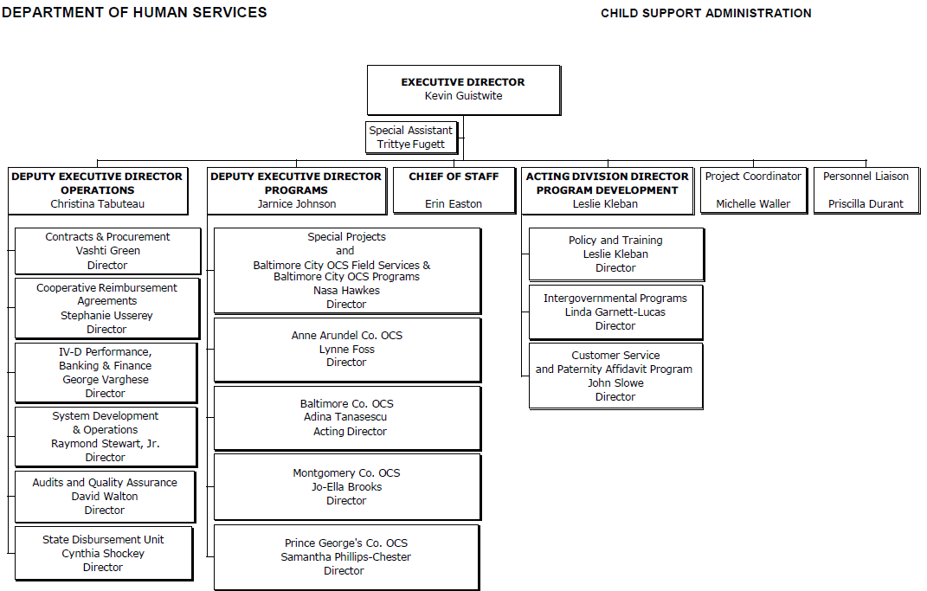

Slide 5
Performance FFY2017 - 2019
 | FFY 2017 | FFY 2018 | FFY 2019
Support Order Establishment | 86.03% | 83.62% | 86.76%
Current Support Collection | 69.01% | 68.73% | 68.90%
Cost Effectiveness | $4.64 | $4.35 | NA
 | FFY 2017 | FFY 2018 | FFY 2019
Paternity IV-D | 98.43% | 98.36% | 95.76%
Cases Paying on Arrears | 70.42% | 70.19% | 70.56%
Collection Per Case | $2,871 | $2,782 | $2,975

Slide 6
CSA Programs
Special Projects
Baltimore City Office of Child Support
Metro Offices

Slide 7
CSA Operations
Contracts & Procurement
Cooperative Reimbursement Agreements (CRAs)
IV Performance, Banking & Finance
System Development & Operations
Audits & Quality Assurance
State Disbursement Unit (SDU)

Slide 8
CSA Program Development
Policy & Training
Intergovernmental Programs
Customer Service & Paternity Affidavit Program

Slide 9
Accomplishments
Customer Service:
Employed 364 noncustodial parents through CSA-led employment programs. Participants contributed $992,000 in collections, a return on investment of $1.98 in collections for every $1 in program expenditures.
Payment Incentive Program Online Application.
Expanded employment and training programs to Wicomico and Worcester Counties.
Enhanced Call Center IVR functions.
Legislation:
SB0001 Amends the term “State’s Attorney” to “Attorney who represents the Child Support Administration” in child support paternity proceedings and defines which State’s Attorneys have authority to act on behalf of the Child Support Administration in a paternity proceeding.

Slide 10
Accomplishments
Programmatic and Operational:
Child Support Guidelines Advisory Committee reviewed 2016 quadrennial review.
New Worker Training and online interactive training on the Introduction to Child Support .
Redesigned performance improvement recognition program for local and metro offices.
Expanded Centralized Mail Processing Program for a total of 23 counties statewide.
No repeat findings in CSA’s most recent Office of Legislative Audits’ Report issued May 2019.

Slide 11
Accomplishments
Technology & Process Improvements:
Pass-through effective July 2019
Work Share Pilot - CSA staff in seven counties work to pool resources and find creative solutions to help hundreds of families in need of child support payments. The pilot program has disbursed $1,010,202.00 owed to custodial parents from August 2018 through August 31, 2019.

Slide 12
FFY 2020 Initiatives
Meet and exceed statewide paternity establishment measure of 90 percent.
Complete Guidelines Advisory Committee tasks.
Expand parent employment programs statewide.
Expand Services for New Hire Reporting contract.
MD THINK - Continue to gather, develop and design the requirements and data standards for the new system.

